Slide 1
Course
AWS Cloud Practitioner
MaxCloud

Slide 2
03
Class
Amazon RDS
Amazon Aurora
AWS DMS
AWS SCT

Slide 3
Amazon ElastiCache
Amazon ElastiCache makes it easy to set up, manage, and scale distributed in-memory cache environments in the AWS Cloud.
It provides a high performance, resizable, and cost-effective in-memory cache, while removing complexity associated with deploying and managing a distributed cache environment.
ElastiCache works with both the Redis and Memcached engines; to see which works best for you, see the Comparing Memcached and Redis topic in either user guide.

Slide 4
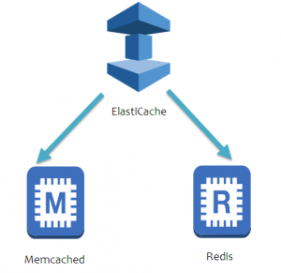
Amazon ElastiCache

Slide 5
Muchas Gracias

